Slide 1
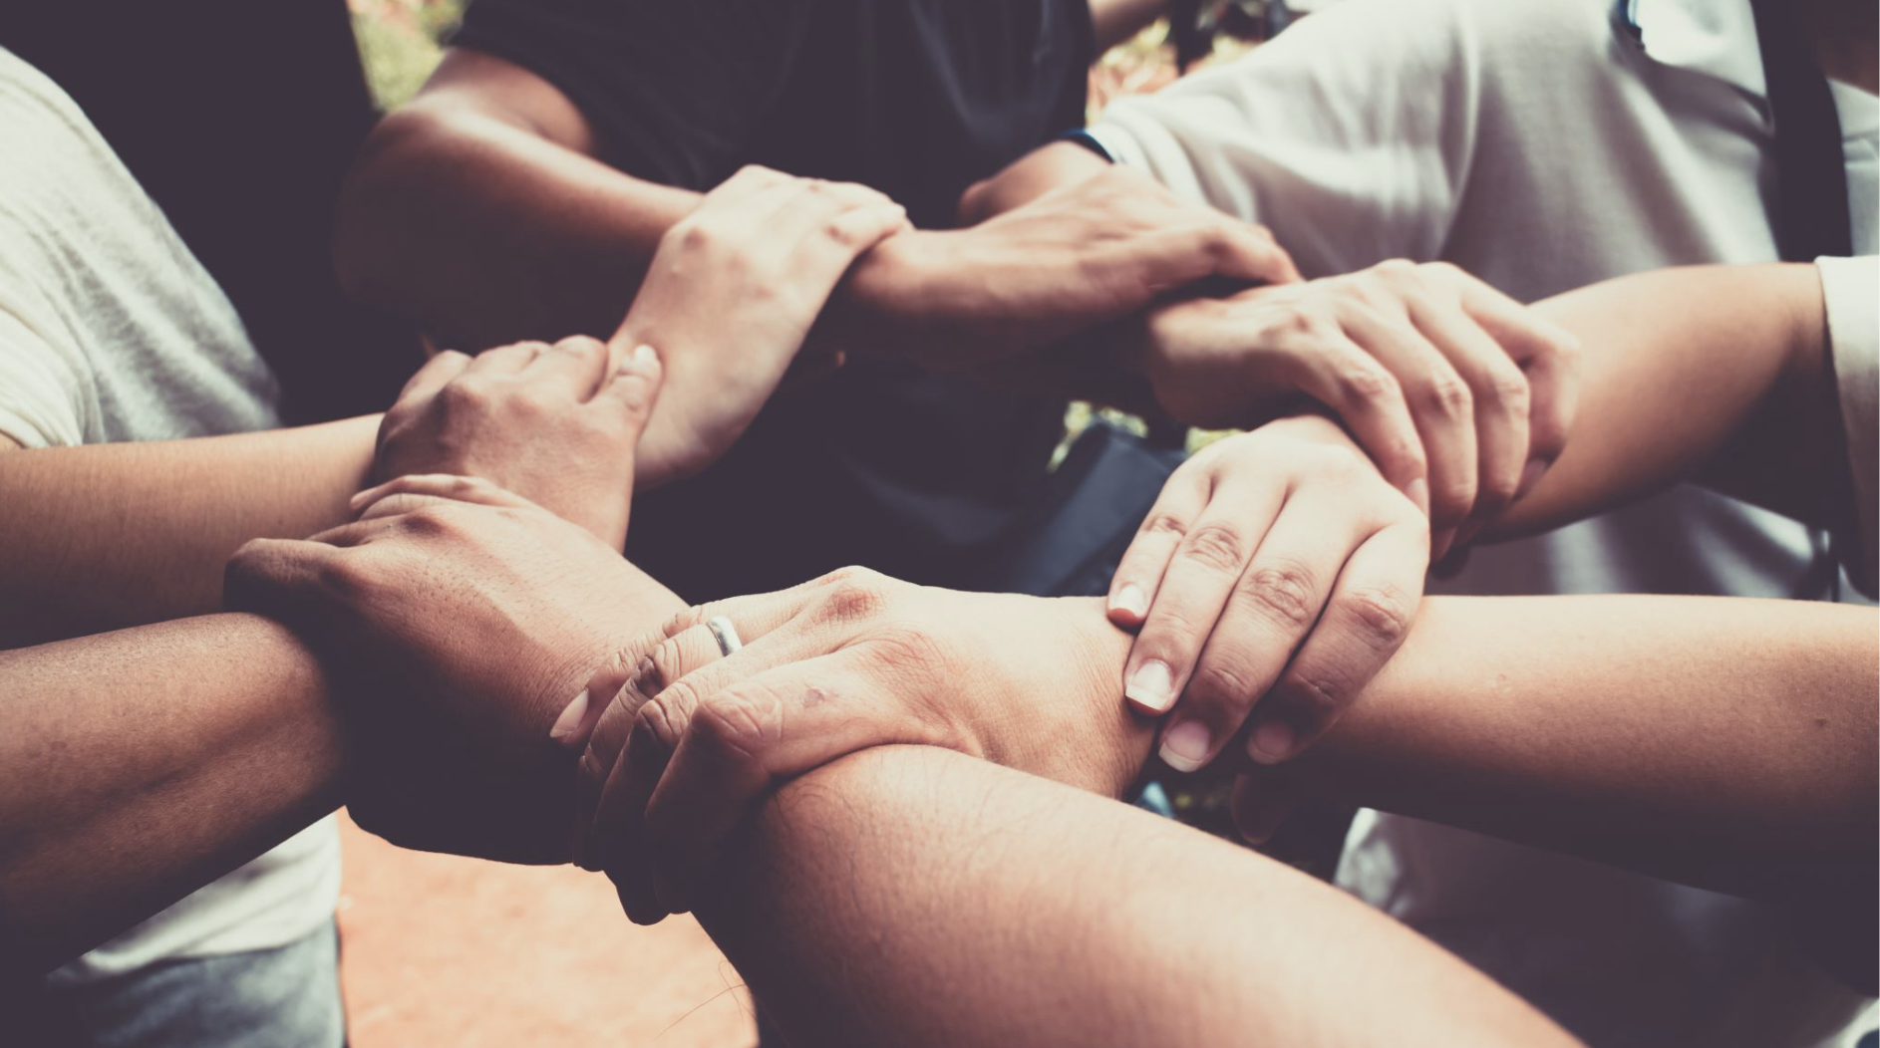
The Value of Friendship

Slide 2
Lesson 1

Slide 3
Discuss

Slide 4
Why might making and keeping friends be important?

Slide 5
What are the differences between relationships VS friendships? If there are any

Slide 6
What are the differences between: being lonely, feeling lonely, and being alone

Slide 7
What is more important, friendships or romantic relationships?

Slide 8
So why do we say "more than friends"?
Don't you think it places friendships at a lower realm in our preferences?

Slide 9
Agree or disagree with the following statements
Notes:
You may use the Tug of War strategy for this

Slide 10
An individual can have a fulfilling life without any friendships

Slide 11
It is easier to make friends at school than in other places.

Slide 12
It is easier for teenagers to make friendships than adults.

Slide 13
The ability to make friends is innate. Sort of "either you have it or not"

Slide 14
We don't have to be friends with everyone, but we have to be friendly to everyone.

Slide 15
Once you have a group of friends, that group will always be with you, no matter what.

Slide 16
Introverts need fewer friends than extroverts.

Slide 17
People who have no friends are just those who are misfits.

Slide 18
Once I have a group of good friends, I am not any more in the "friends market".

Slide 19
Friendships are made organically (like mushrooms popping up under some random tree) rather than by making a conscious effort.

Slide 20
Only popular individuals are good at making friends

Slide 21
Current generations have it harder to make meaningful, enriching and long-lasting relations than previous generations

Slide 22
Your advisor can tell you...
Does making and keeping friendships require active effort?

Slide 23
Get in pairs
and create a visual (poster) with brief ideas that supports the following statements. You can do some quick research

Slide 24
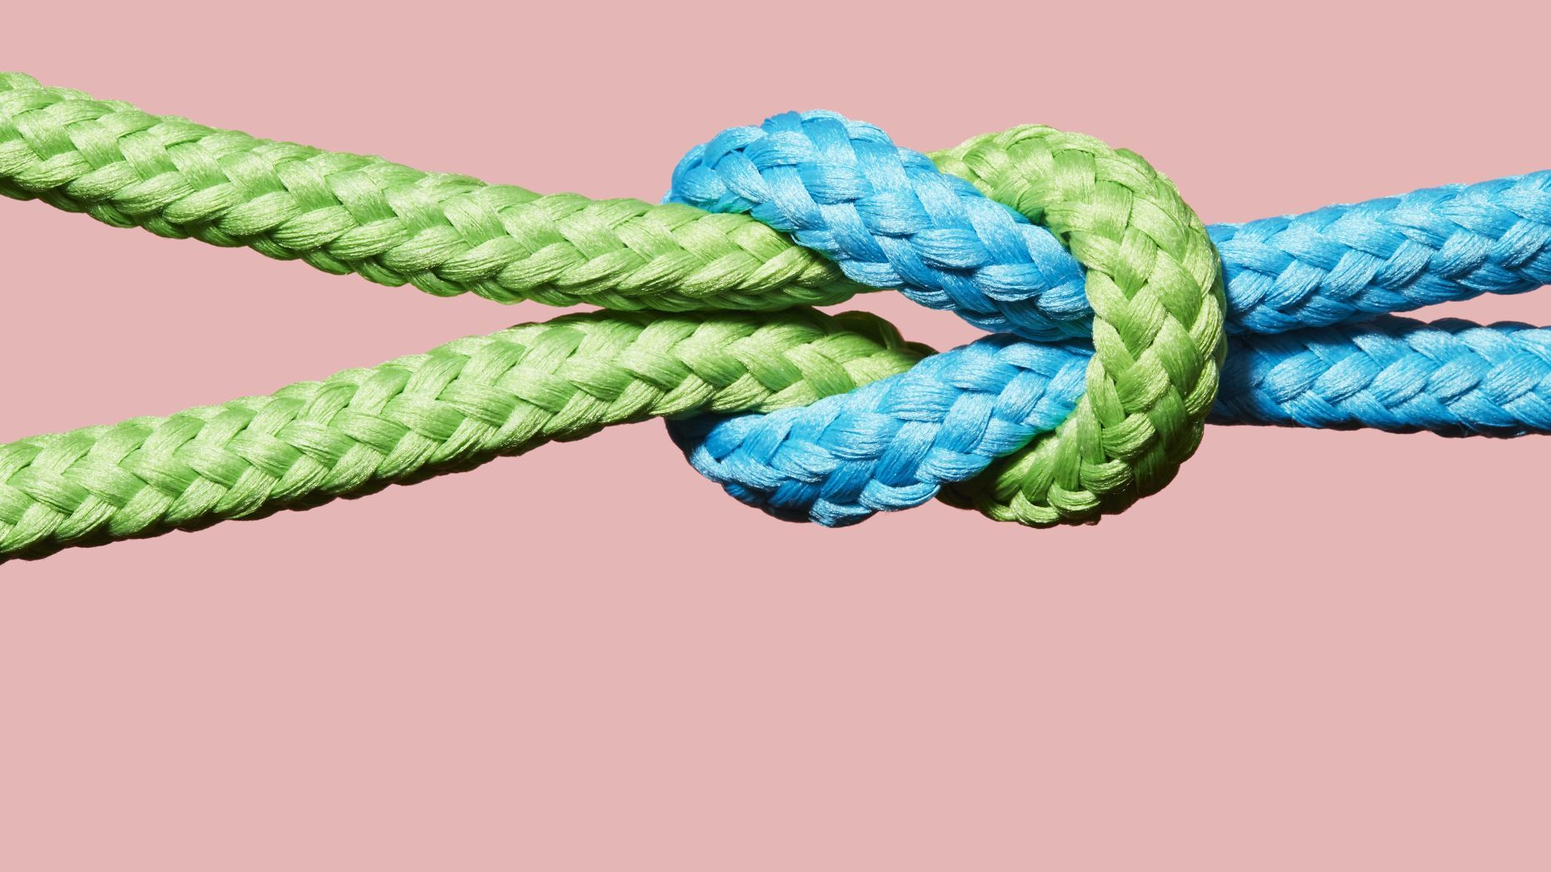
Friendship makes us whole (Pair 1)

Slide 25
Friendships can make us more empathic and open-minded (Pair 2)

Slide 26
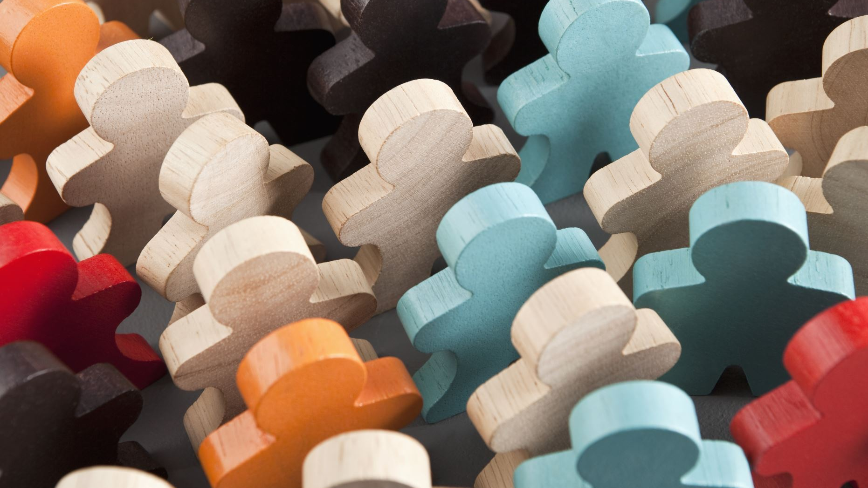
Friendship helps us to figure out who we are (Pair 3)

Slide 27
Friendship can make us more resilient (Pair 4)

Slide 28
Lesson 2

Slide 29
What the current science says

Slide 30
Similar terms that appear in research journals to refer to friendship. What do you think?
INTEGRATION OF OTHERS WITHIN YOUR OWN SELF
AFFILIATION
ATTACHMENT

Slide 31
It even goes back to 1992...
The study followed 6,928 participants aged 51 to 61 years old over a 9-year period and examined the association between social ties and mortality after myocardial infarction. The findings showed that individuals with a strong social network, including close friendships, had a 50% lower risk of mortality than those who were socially isolated
Berkman LF, Leo-Summers L, Horwitz RI. Emotional support and survival after myocardial infarction. A prospective, population-based study of the elderly. Ann Intern Med. 1992 Jul 1;117(1):100-6. doi: 10.7326/0003-4819-117-1-100. PMID: 1596044.

Slide 32
Another study from 2010...
The study followed 7,108 individuals over a two-year period and examined the relationship between social support and physical health. The study found that individuals with higher levels of social support, including strong friendships, had better physical health than those with lower levels of social support.
The study found that individuals with higher levels of social support had better overall physical health, fewer symptoms of illness, and fewer functional limitations than those with lower levels of social support. The study also found that social support was associated with a lower risk of chronic conditions such as diabetes, heart disease, and hypertension.
Holt-Lunstad, J., Smith, T. B., Baker, M., Harris, T., & Stephenson, D. (2010). Loneliness and social isolation as risk factors for mortality: A meta-analytic review. Perspectives on Psychological Science, 10(2), 227-237. doi: 10.1177/1745691610393522

Slide 33
Some statistics (UK)
In total , 45% of adults feel occasionally, sometimes or often lonely in England. This equates to twenty five million people.
In 2016 to 2017, there were 5% of adults (aged 16 years and over) in England reporting feeling lonely “often/always” – that’s 1 in 20 adults. Furthermore, 16% of adults reported feeling lonely sometimes and 24% occasionally.
References

Slide 34
Some statistics (US)
4 times as many people now, compared to the early 90s, reported they have no friends
Survey data from 2019 shows that 58% of Americans often felt like no one in their life knew them well. In 2020, young women in the US were most likely to report losing touch with friends. Most Americans are seeking more friendships and connectedness than ever.
Reference

Slide 35
Consequences of chronic loneliness
reduce cognitive skills, such as the ability to concentrate, make decisions, problem-solve
Loneliness is likely to increase your risk of death by 26% (Holt-Lunstad, 2015)
Loneliness, living alone and poor social connections are as bad for your health as smoking 15 cigarettes a day. (Holt-Lunstad, 2010)
Loneliness is worse for you than obesity. (Holt-Lunstad, 2010)
Your social network has higher impact to how long you live than your diet or exercising

Slide 36
In short
Cutting edge research is conclusive: After sound sleep, forming trustworthy and reliable relationships is the best indicator to have fulfilling and long life

Slide 37
Learn the skill
Because forming and keeping friendships is a skill rather than an innate talent. Agree?

Slide 38
Learn the skill

Slide 39
First is first: if you don't have a thriving social network, you are part of the norm.
You are not a misfit or a weirdo. Forming stimulating and enriching relationships require a set of skills, reminders​, and conscious effort.

Slide 40
Some skills
Highlighted parts are explanations that we wrote for teachers, feel free to adapt them
Self-compassion. Treat yourself like someone you are responsible for helping.
Conscious and frequent effort. It is a practice that requires action and care. Put yourself out there. If you had a nice time with someone, making him / her know
Willingness and courage to show yourself as you are. Be vulnerable but not oversharing (telling your deepest secrets to everyone that is a sign of low self-esteem. Showing your true self is a sign of trust on the other person and it shows personal strength and courage.
Resilience and acceptance for rejection. Understanding that rejection is part of the process. Meaning you got one rejection and you decide to conclude that you are a socially awkward monster. The contrary, there may be multiple explanations for that, somebody did not greet you back? Maybe she had a bad day or is busy thinking about their problems.
Positive outlook. Cherish little details we take for granted, did someone take the time to reply your message back in a friendly way? Make a pause and appreciate that

Slide 41
Dr. Marisa G. Franco.
Dr. Franco is a New York Times bestselling author, professor, and psychologist. She communicates the science of connection in digestible ways and is passionate about sharing research with the people it could help the most. She is a great advocate who appears in many podcasts.

Slide 42
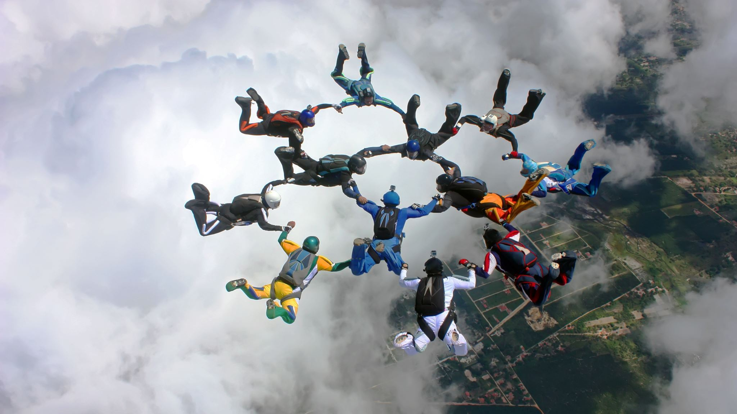
Assess Your Friendship skills
Take the survey

Slide 43
Discuss the results and the traits that Dr Franco highlights.

Slide 44
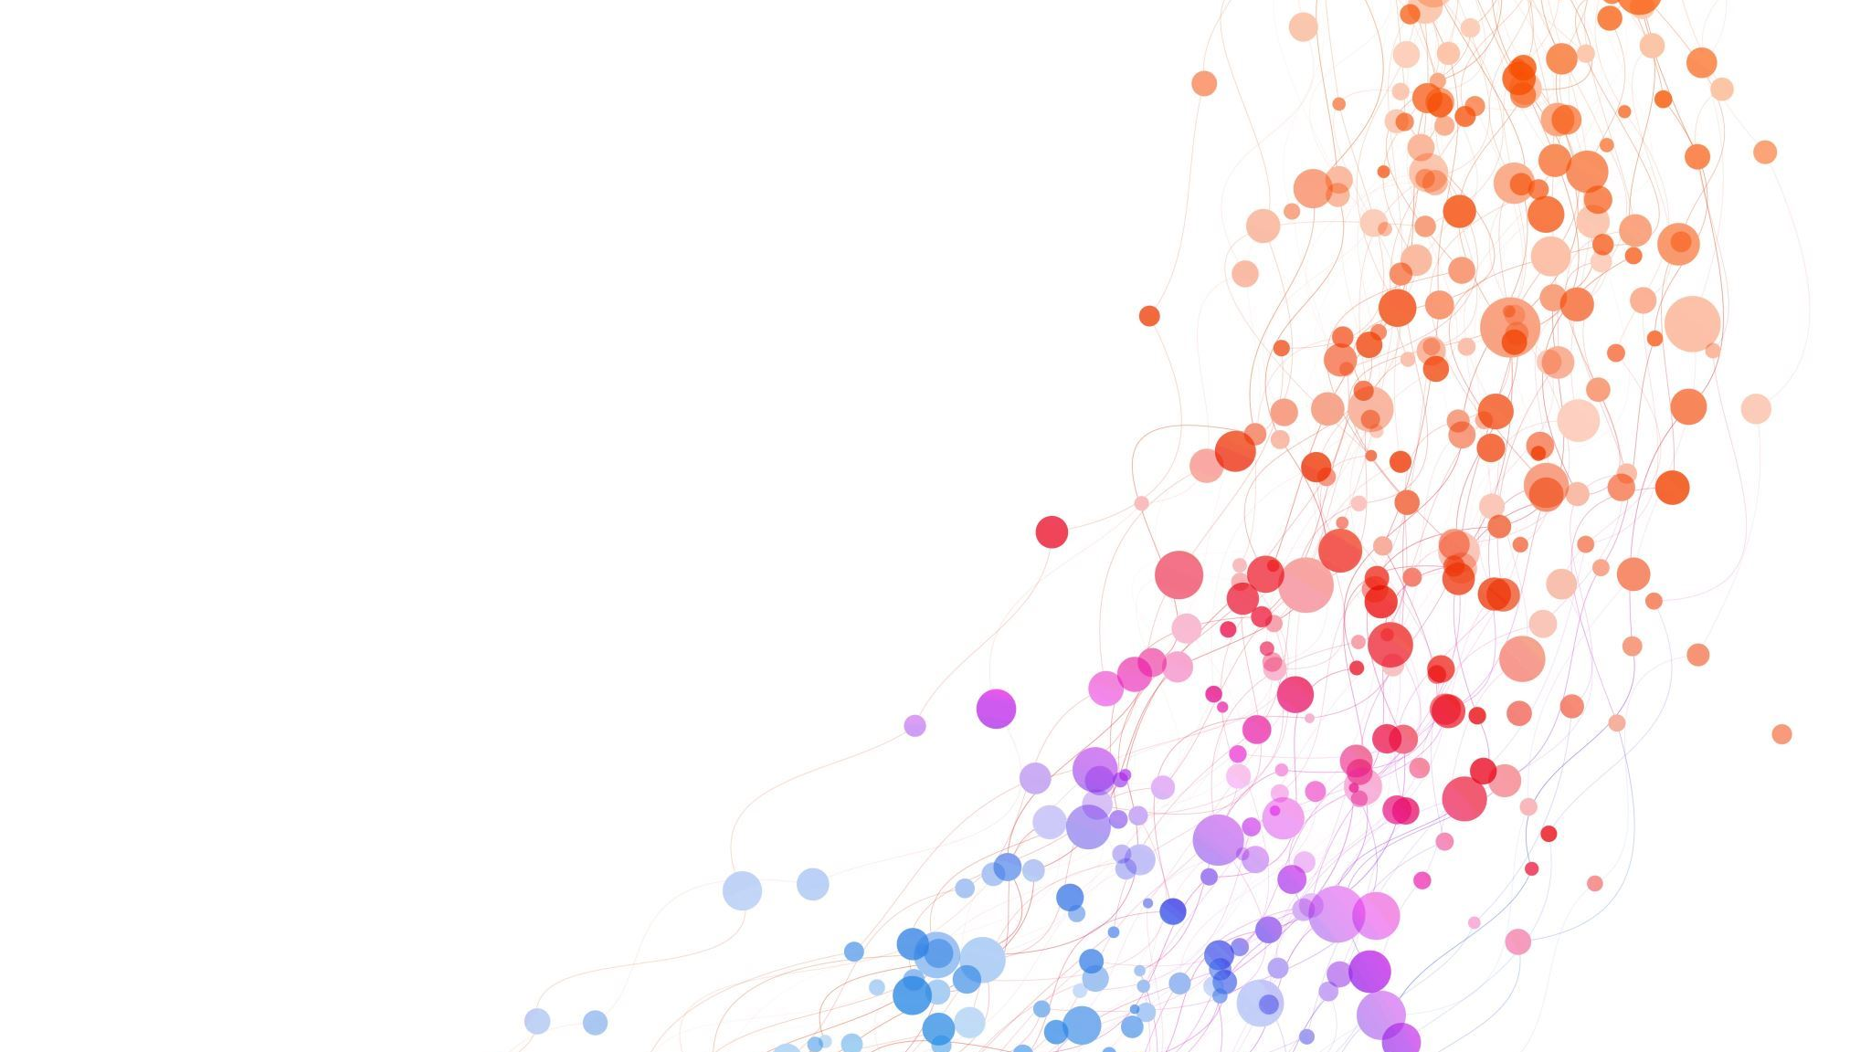
Lesson 3

Slide 45
Perspective taking. A role-play experience

Slide 46
Divide the advisory in 3 or 4 groups
Each group will be given a scenario that involves a social situation where perspective-taking is important.
Discuss the scenario and come up with a plan of action for the person in the scenario. Think about the perspectives of all the people involved in the scenario, and to consider how they might feel and why.
After the groups have had time to discuss and come up with a plan, each group will share their plan with the class. Encourage the class to ask questions and provide feedback on the plans.
Facilitate a class discussion on the importance of perspective-taking in making and maintaining friendships. Ask students to share their own experiences with perspective-taking and discuss how it can be difficult but ultimately rewarding. Encourage students to think about how they can use perspective-taking in their own lives to improve their friendships.

Slide 47
Scenario 1: "New in Town"

Slide 48
Characters
Jenny just moved to a new town and is starting at a new school. She doesn't know anyone and is feeling very nervous about making friends. She's a bit shy and isn't sure how to approach new people. She's also worried that she won't fit in or that people won't like her because she's new.
Emily: Emily is a friendly girl who sits next to Jenny in class. She notices that Jenny is new and tries to strike up a conversation with her, but Jenny is too nervous to respond.
Jacob: Jacob is the star of the football team. He's popular and well-liked by most of the students. Jenny sees him in the hallway and feels intimidated by his popularity and athleticism.
Ms. Smith: Ms. Smith is Jenny's English teacher. She notices that Jenny is new and takes the time to introduce herself and offer to help Jenny if she needs anything

Slide 49
Lina & Hannah : suggestions to the students in scenario 1
Jenny should try talking to people or speaking up in class. She can also ask questions if she doesn’t understand something and make friends this way.
Emily and Ms. Smith should be supportive and encourage Jenny to take risks and adjust to the new environment.
Emily should find common topics of discussion with Jenny and try to raise her interest and not give up if Jenny isn’t enthusiastic the first time.
Jenny should become friends with Emily and get to know Jacob through Emily. Once they are more familiar, Jenny won’t be as intimidated.

Slide 50
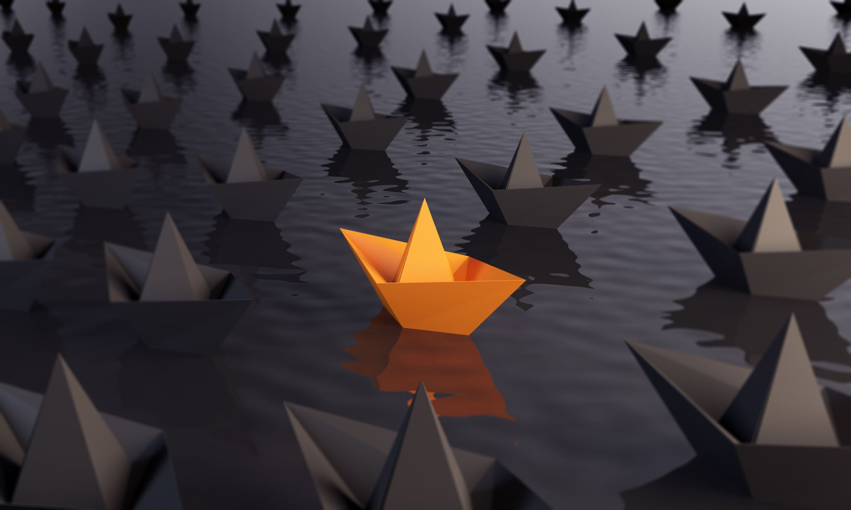
Scenario 2: Different interests

Slide 51
Characters
Mark is a talented musician who spends most of his free time playing guitar and writing songs. He's passionate about music and loves to share his creations with others. However, most of the other students in his school aren't very interested in music and don't understand his passion. Mark is having trouble finding friends who share his interests and appreciate his talents. Some other characters that Mark might interact with in this scenario are:
Samantha: Samantha is a cheerleader who sits next to Mark in math class. She notices that he always wears band t-shirts and has a guitar pick necklace, but she doesn't know much about music and feels like they don't have much in common.
Mr. Brown: Mr. Brown is the music teacher at Mark's school. Mark loves going to his music class and feels like he can be himself around Mr. Brown. However, he wishes that he had more opportunities to collaborate with other students who are passionate about music.
Ben: Ben is a new student who recently moved to town. He plays bass guitar and is looking for other musicians to start a band with. Mark meets Ben in the hallway and they bond over their shared love of music. However, they soon realize that their musical tastes are very different, and they struggle to find common ground.

Slide 53
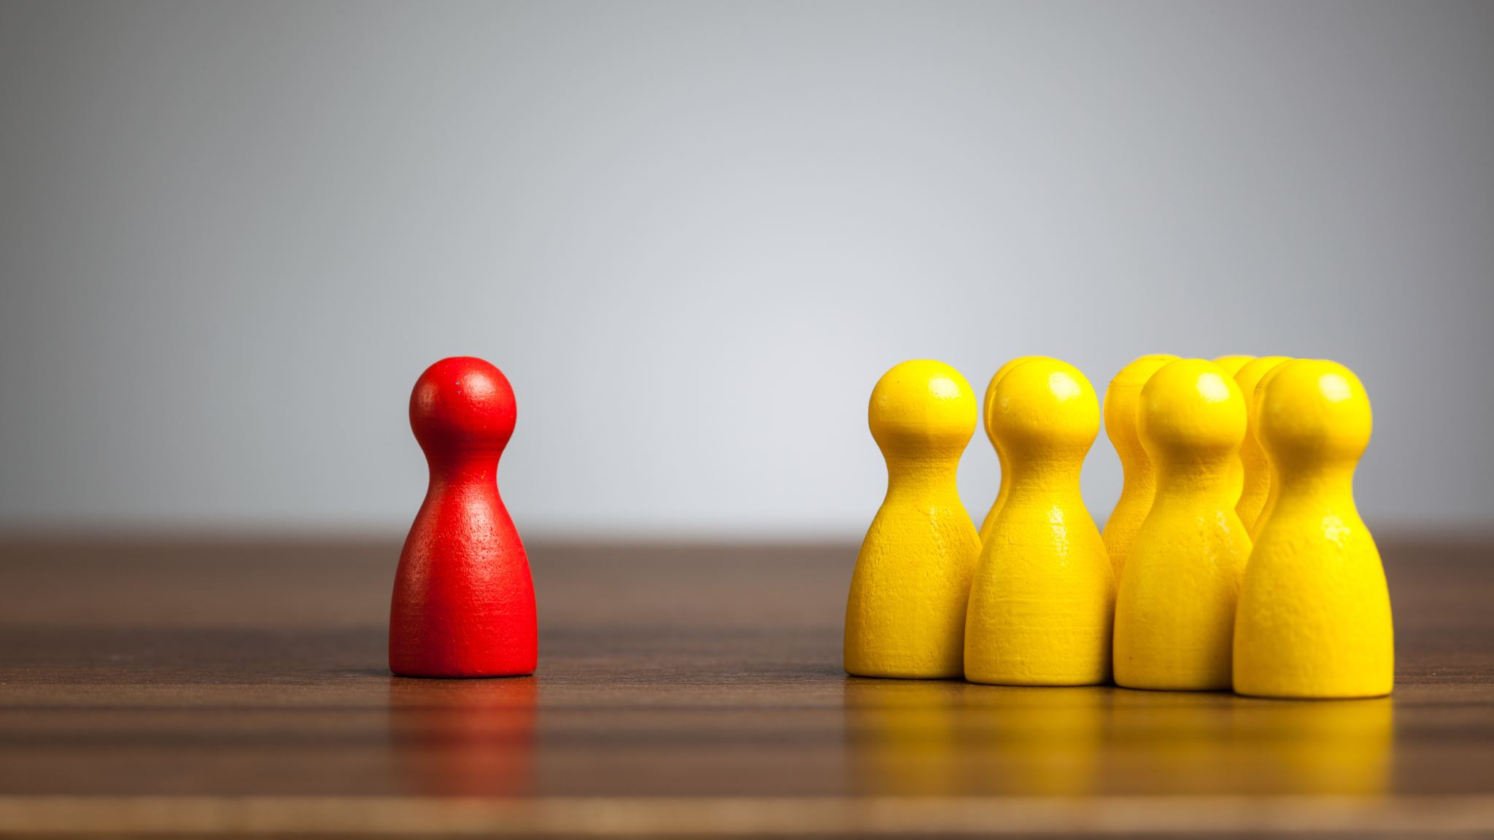
Scenario 3: Misunderstood Humor

Slide 54
Characters
Emily loves to make people laugh and often uses humor to lighten the mood and connect with others. However, her humor can be sarcastic and dry, and she sometimes has trouble knowing when to stop joking around. Some of her classmates find her humor off-putting or don't understand her jokes, and Emily feels like she's always walking a fine line between being funny and being annoying. Some other characters that Emily might interact with in this scenario are:
Alex: Alex is a new student who recently transferred to Emily's school. Emily notices that Alex is quiet and seems a bit shy, so she tries to use humor to help him feel more comfortable. However, Alex doesn't understand her jokes and starts to feel like Emily is making fun of him.
Brianna: Brianna is one of Emily's closest friends. She loves Emily's humor and thinks that she's one of the funniest people she knows. However, sometimes Brianna worries that Emily's jokes might hurt someone's feelings or be taken the wrong way.
Mr. Johnson: Mr. Johnson is Emily's English teacher. He notices that Emily often uses humor in her writing and encourages her to explore this talent further. However, he also reminds her that humor can be a powerful tool that can either build bridges or create barriers between people.

Slide 55
For this scenario, Emily is a person that enjoys to make humor, however, her jokes sometimes make people to get uncomfortable and thinks she's making fun on him/her.

Slide 56
Scenario 4: "Online Collaboration"

Slide 57
Characters
David is a student who loves to collaborate with others on school projects, but he often struggles with online communication. He finds it difficult to express himself clearly in writing and sometimes misunderstands what his classmates are trying to say. Some other characters that David might interact with in this scenario are:
Maria: Maria is David's lab partner, and they're working on a project about the water cycle. They've been communicating via email and Google Docs, but David is having a hard time understanding what Maria wants him to do for their next assignment.
Kevin: Kevin is one of David's classmates who always seems to have a clear understanding of what's going on in their group projects. David sometimes feels intimidated by Kevin's confidence and isn't sure how to express his own ideas when they're collaborating online.
Ms. Lee: Ms. Lee is David's science teacher, who has noticed that David has been struggling with online communication. She encourages him to practice expressing his thoughts more clearly and gives him some tips on how to communicate effectively with his classmates online.

